Slide 1

Brightspeed
Acquisition of Lumen ILEC business
Access Carrier Forum
July 21, 2022

Slide 2
Our Agenda
About the Brightspeed Transaction
Calendar of Events
Ordering
Data Feeds
Trouble Administration
Billing

Slide 3
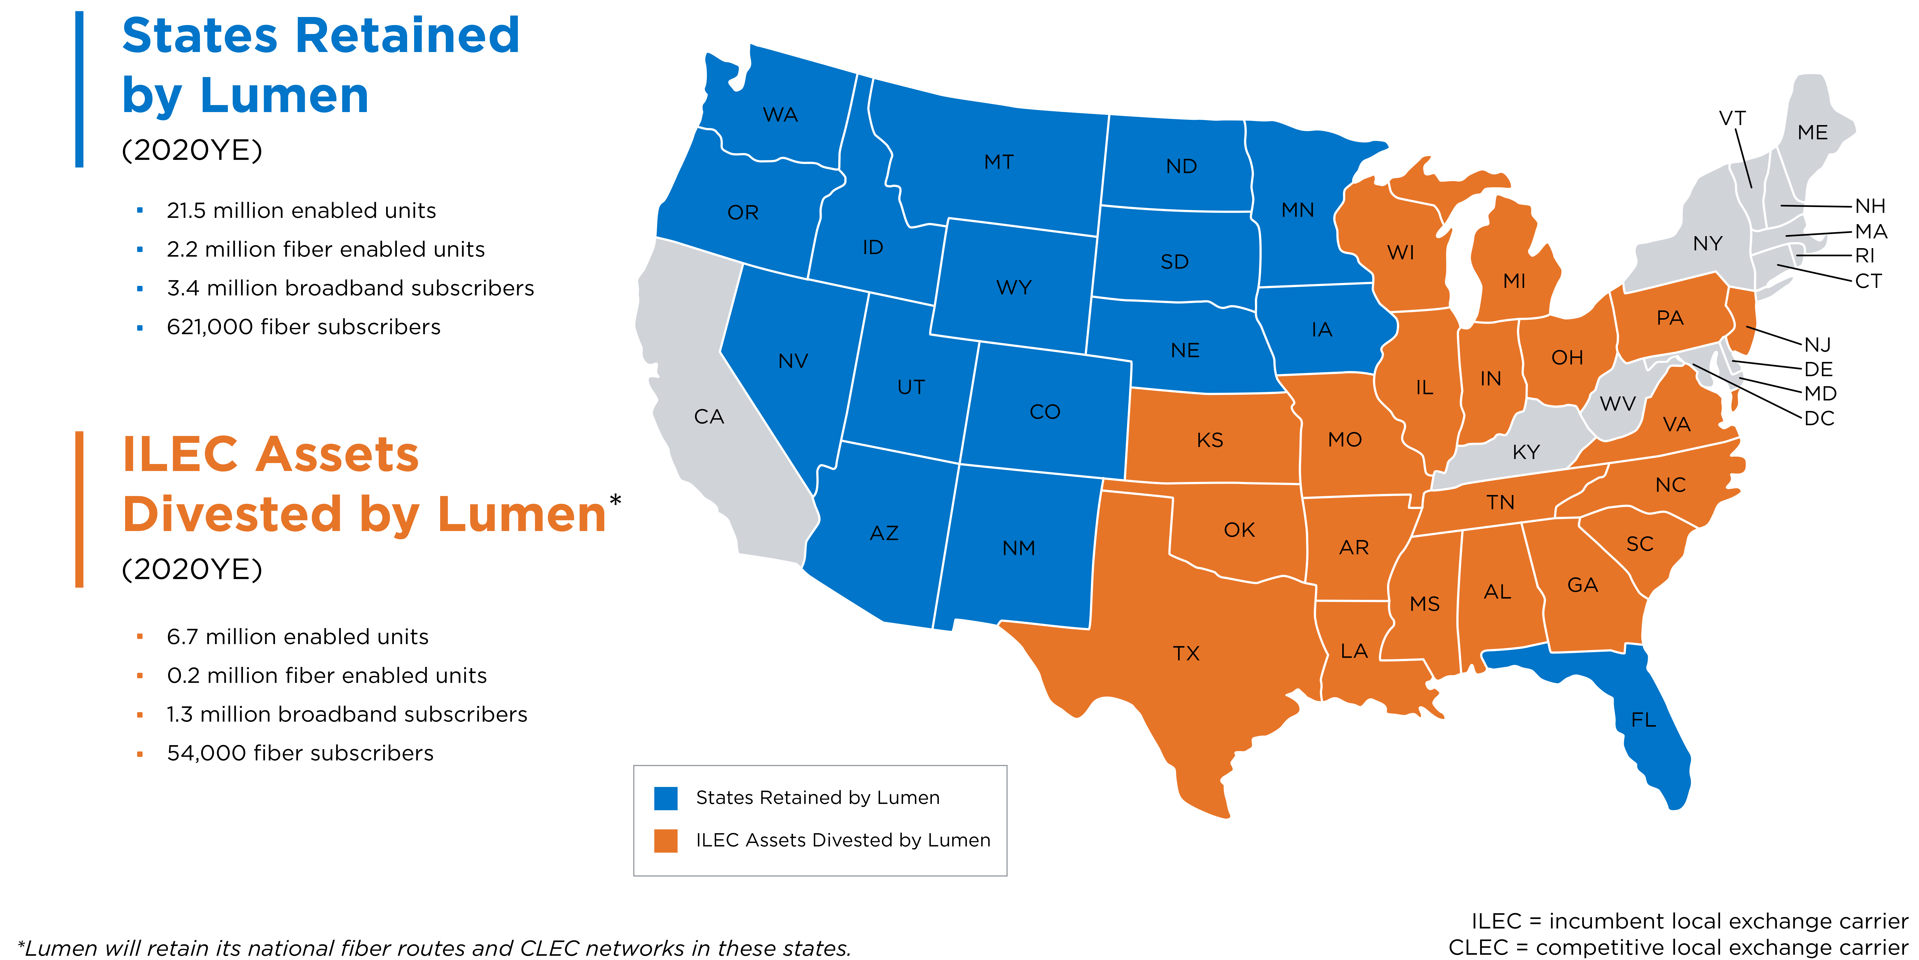
About the Brightspeed Transaction
Brightspeed has reached an agreement to acquire Lumen’s Incumbent Local Exchange Carrier (ILEC) entities that provide services to residential, commercial and wholesale customers in Alabama, Arkansas, Georgia, Illinois, Indiana, Kansas, Louisiana, Michigan, Mississippi, Missouri, New Jersey, North Carolina, Ohio, Oklahoma, Pennsylvania, South Carolina, Tennessee, Texas, Virginia and Wisconsin.

Slide 4
Calendar of Events

Slide 5
Calendar of Events (cont…)
June 2022
SUNDAY | MONDAY | TUESDAY | WEDNESDAY | THURSDAY | FRIDAY | SATURDAY
 |  |  | 1 | 2 | 3 | 4
5 | 6 | 7 | 8 | 9 | 10 | 11
12 | 13 | 14 | 15 | 16 | 17 | 18
19 | 20 Customer Communication Package distributed | 21 | 22 | 23 | 24 | 25
26 | 27 | 28 | 29 | 30
July 2022
SUNDAY | MONDAY | TUESDAY | WEDNESDAY | THURSDAY | FRIDAY | SATURDAY
 |  |  |  |  | 1 | 2
3 | 4 | 5 | 6 | 7 | 8 | 9
10 | 11 | 12 | 13 | 14 | 15 | 16
17 | 18 | 19 | 20 | 21 LUMEN/Brightspeed Customer Forum Call | 22 | 23
24 | 25 | 26 | 27 | 28 | 29 | 30
31

Slide 6
Calendar of Events (cont…)
August 2022
SUNDAY | MONDAY | TUESDAY | WEDNESDAY | THURSDAY | FRIDAY | SATURDAY
 | 1 Customer Testing Opens | 2 | 3 | 4 | 5 | 6
7 | 8 | 9 | 10 | 11 | 12 | 13
14 | 15 | 16 | 17 | 18 | 19 | 20
21 | 22 | 23 | 24 | 25 | 26 | 27
28 | 29 | 30 | 31
September 2022
SUNDAY | MONDAY | TUESDAY | WEDNESDAY | THURSDAY | FRIDAY | SATURDAY
 |  |  |  | 1 | 2 | 3
4 | 5 | 6 | 7 | 8 | 9 | 10
11 | 12 | 13 | 14 | 15 LUMEN/Brightspeed Customer Forum Call | 16 Customer Testing Ends | 17
18 | 19 | 20 | 21 | 22 | 23 | 24
25 | 26 | 27 | 28 | 29 | 30 Brightspeed Acquisition Close

Slide 7

Operations Support Systems (OSS)
To support Brightspeed, for a transitional time after the closing of the sale, LUMEN will provide Operational Support Systems (OSS) for customers in the 20 states acquired by Brightspeed.
Ownership of the replicated OSS will be transferred to Brightspeed at close. OSS operating under the TSA agreement will be transferred at a date yet to be determined.
Bonded (UOM) customers for ordering systems will utilize existing LUMEN connections.
VFO GUI Users will have duplicated access to the Brightspeed ordering instance thru a replicated VFO GUI via a unique URL.
As part of the transition, Lumen will continue to provide the PTA platform in the Brightspeed impacted states in the same manner as it does today.
More information is available at: https://news.lumen.com/brightspeed-wholesale
Notes:
Scott’s changes

Slide 8
Ordering

Slide 9

Access Ordering
General Information
Interexchange Carrier Service Code (ICSC)
Brightspeed will assume ownership of the ICSCs shows on the next slide at close.
LUMEN will retain the use of the MG04 and SM01 ICSCs.
ASR requests to the properties in KS, MO, TX previously under MG04 must be submitted under CH10 post-close.
Converted CCLC assets ordered under the ICSC of SM01 must be submitted to CenturyTel Broadband Services under the ICSC of CT20 post-close.

Slide 10
Impacted ICSC / OCN
State | ICSC | OCN/ NECA
Alabama | CT82 | 9789
Alabama | CT83 | 9788
Alabama | GF01 | 0298
Arkansas | CJ01 | 1144
Arkansas | CR05 | 1142
Arkansas | CS20 | 1143
Arkansas | IL16 | 1706
Arkansas | IL18 | 1727
Arkansas | MG10 | 1711
Arkansas | RT10 | 1720
Georgia | CU01 | 0356
Illinois | MR10 | 1057
Indiana | ID34 | 0747
Indiana | ID49 | 0801
Indiana | OH03 | 0832
Kansas | MG04 CH10 | 1842
Kansas | MG04 CH10 | 1317
Kansas | MG04 CH10 | 1810
Kansas | MG04 CH10 | 1812
Louisiana | ET01 | 0434
Louisiana | IL18 | 1727
Louisiana | IS70 | 0427
Louisiana | IS77 | 0439
Louisiana | IT57 | 0424
Louisiana | IT58 | 0423
Louisiana | IT59 | 0440
Louisiana | IT60 | 0436
Louisiana | IT61 | 0431
Louisiana | LW01 | 0442
Michigan | CT22 | 0702
Michigan | IB40 | 0671
Michigan | IB53 | 0705
Michigan | PC10 | 0689
State | ICSC | OCN/ NECA
Mississippi | IT53 | 0458
Mississippi | IT54 | 0552
Missouri | CM02 | 1151
Missouri | CT84 | 9785
Missouri | CT85 | 9786
Missouri | CT86 | 9787
Missouri | CT87 | 9784
Missouri | MG04 CH10 | 1811
New Jersey | EG05 | 0138
North Carolina | CT02 | 0471
North Carolina | IS97 | 0485
North Carolina | IS97 | 0485
North Carolina | NC01 | 0470
Ohio | IC04 | 0630
Ohio | OH03 | 0661
Oklahoma | See Arkansas
Pennsylvania | EG05 | 0209
South Carolina | UM01 | 0506
Tennessee | IT38 | 0574
Tennessee | IT54 | 0552
Tennessee | IT55 | 0557
Tennessee | UM01 | 4510
Texas | CN01 | 2114
Texas | IL17 | 2117
Texas | MG04 CH10 | 2084
Texas | SM10 | 2140
Texas | VV01 | 2101

Slide 11

Access Ordering
General Information
Circuit Identification
At close, Brightspeed will retain the ILEC circuit and Telco IDs previously used by LUMEN.
No changes will be made to embedded base circuit IDs.
Two-Six Codes (TSCs)
Brightspeed will assume Two Six Codes (TSCs). No changes will be made to embedded base TSCs.
Trunk Group Numbers (TGN)
Brightspeed will assume existing Trunk Group Numbers (TGN). No changes will be made to embedded base.
All existing LUMEN ASR processes and Requirements will remain effective with Brightspeed at close including:
The Carrier is responsible for populating the SPEC field on the incoming ASR.

Slide 12

Access Ordering
General Information
Inflight orders
Inflight orders will not require any CLEC/Carrier intervention.
Contracts and VTA population
Orders against Forborne contracts require the carrier to populate the contract ID in the PNUM field in order to receive the applicable discount.
When requested a discounted payment plan, the VTA field must be populated by the carrier.
LERG/NECA
LERG and NECA updates will be made at close. Specifically, LERG updates will be made one minute after midnight of closing date and NECA records will be transferred to Brightspeed on the first of the month following close, per industry standard timing.
SPID
Brightspeed will retain the overall company SPID of 0661 for all Brightspeed territories.
LUMEN will convert all remaining territories to an overall company SPID of 2223.

Slide 13

Access Ordering
General Information
A mirror copy of open and/or active LUMEN ASRs/LSRs for the impacted states at close, will be available in the Brightspeed VFO/EP OSS post-close, once system standup is completed.
Bonded Carriers/CLECs will have access to inflight transactions via the Brightspeed VFO. Carrier/CLECs will not be required to submit any changes in connectivity.
Brightspeed Wholesale Operations Website will be published at close.
New URL (for EASE) to be provided
Contacts will be published
Ordering References will mirror those available from LUMEN today.
  Ordering Job Aids
  Ordering Samples
  Technical References
  Access Operational Support Systems and OSS References
  Online Training and Training Guides

Slide 14
Trouble Administration
At close, active services inventories will be live in production and available for CLEC/Carrier to report troubles electronically once the system standup is complete and available.
Inflight Trouble Reports will not require any CLEC/Carrier intervention.
Current staff supporting troubles in the acquired properties will continue to support trouble reporting post-close.
Contact Number to Report Repairs for the acquired properties will published on the Brightspeed Wholesale Operations website at close.
Full list of contacts and escalation Peer-to-Peer chart will be published on the Brightspeed Wholesale Operations website at close.

Slide 15
Billing

Slide 16

Carrier Access Billing
(CABS)
Bill cycles will remain as-is.
Currently not planning for Billing Account Number (BAN) changes
Electronic Billing Options will not change, but Invoices files will be split as noted under Data Feeds.
Meet-Point Billing
  Brightspeed has no plans to change the Meet-Point Billing process at close. The ICSCs/OCNs for the properties being acquired will transfer to Brightspeed at close.
Access (CABS) Billing Disputes
  Dispute Process and Claim Templates will be published on the Brightspeed Wholesale Operations Website at Close.
  Billing Contacts will be available form the Brightspeed Wholesale Operations Website at close.

Slide 17

Wholesale Billing
(Ensemble)
Services such as Resale, LWS, UNE-P, etc. currently billed in Ensemble
Bill cycles will remain as-is.
Billing Account Number (BAN) changes will take place in order to split sites and services between Lumen and Brightspeed states.
Electronic Billing Options (EDI) will have new ISA number and EDI ids, for the Brightspeed invoices. Lumen invoices will remain under their existing EDI ids.
Billing Disputes
  Dispute Process and Claim Templates will be published on the Brightspeed Wholesale Operations Website at Close.
  Billing Contacts will be available form the Brightspeed Wholesale Operations Website at close.

Slide 18
Billing Feeds
Brightspeed Electronic billing feeds are available and may be requested by completing and submitting the Brightspeed Billing Media form including:
Billing Data Tapes (BDT) for CABS access billing and Local billing
  Customers will receive a unique file for BDT separate from LUMEN BDT files
  The new feed will be sent to the existing sites but will add a unique identifier (.BSD) before the date/time stamp to denote Brightspeed to the receiving filename.
Customers will continue to receive existing files for
  Daily Usage Files (DUF)
  Meet Point Billing (MPB)
URL for Billing Media form will be determined at close.
Brightspeed will coordinate all media changes to LUMEN for processing.

Slide 19

Questions…..
Questions…

